Slide 1
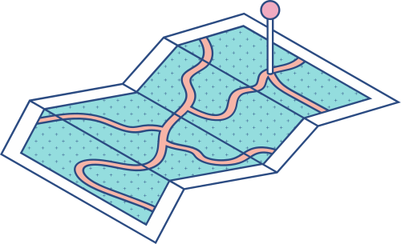





DEEP DIVE INTO CONTAINERS
Control Groups (cgroups): Managing Resources
A Comprehensive Guide to Containerization

Slide 2



Agenda
KEY TOPICS DISCUSSED IN THIS PRESENTATION
Concepts and Evolution of cgroups Hierarchical Resource Management: CPU, Memory, I/O, Block Devices Integrating cgroups with Namespaces

Slide 3

Managing Resources
Control Groups, commonly known as cgroups, are an
integral part of modern containerized environments, providing
robust mechanisms for resource management. Their
primary function is to partition, account for, and limit
physical resources such as CPU, memory, disk I/O, and
network bandwidth among groups of tasks.

Slide 4

Concepts and Evolution of cgroups

Slide 5
Introduction
Control groups, commonly known as cgroups, represent a
foundational paradigm in operating system resource management
that has evolved in tandem with the dramatic
increase in workload diversity and scale in modern computing
environments.

Slide 6
Hierarchical Resource Management: CPU, Memory, I/O, Block Devices

Slide 7
Integrating cgroups with Namespaces

Slide 8
Introduction
The rapid evolution of container technology has been fueled
by the need to isolate applications, secure sensitive
data, and efficiently manage shared computing resources.
At the core of Linux containerization lie two complementary
constructs: control groups (cgroups) and namespaces.
Cgroups provide a robust mechanism for partitioning and
managing system resources—such as CPU, memory, I/O,
and block devices—across sets of processes, while namespaces
offer a means to encapsulate the global system state
into isolated environments.

Slide 9

Fundamentals of cgroups
Control groups, or cgroups, function as the kernels’ instrument
for aggregating and limiting resource usage by
individual processes or groups of processes. At a high level,
cgroups operate by attaching processes to a hierarchical
tree where each node defines limits, prioritizations, and
accounting policies for various resource domains. This treelike
structure allows administrators to set base resource
allocations at the root and then delegate or restrict these
resources successively to subordinate subgroups.

Slide 10
Fundamentals of Namespaces
Namespaces, another cornerstone of Linux containerization,
provide the isolation boundaries necessary to confine
processes within their own “private” copy of certain global
resources. Introduced to overcome the limitations of traditional
process isolation, namespaces enable each container
to have a unique view of aspects such as the process ID
space (PID namespace), network interfaces (network namespace),
filesystem mounts (mount namespace), and system
identifiers (UTS namespace).

Slide 11
Conclusion
The integration of cgroups and namespaces represents a triumph
of modern operating system design, marrying robust
resource control with stringent isolation guarantees. By
combining the fine-grained resource management capabilities
of cgroups with the comprehensive isolation features
of namespaces, Linux containers achieve an unprecedented
level of efficiency and security. This dual mechanism not
only addresses the challenges inherent in multi-tenant environments
but also provides the technical foundation for the
advanced container orchestration systems that dominate
today’s cloud computing landscape.

